Slide 1
Algorithms: Decrease and Conquer
For: CSCI 163A / COEN 179
By: Navid Shaghaghi

Slide 2
Decrease-and-Conquer
A technique for solving problems by exploiting the relationship between a solution to a given instance of a problem and a solution to its smaller instance.
It can be exploited either
Top Down: a recursive implementation
Bottom Up: usually implemented iteratively (A.K.A. Incremental Approach)

Slide 3
Decrease-and-Conquer Major Variations
decrease by a constant
Examples: Factorials, Insertion Sort
decrease by a constant factor
Examples: Binary Search, Exponentiation by Squaring, Russian Peasant Multiplication
variable size decrease
Examples: Euclid’s algorithm

Slide 4
Decrease-by-a-Constant
A decrease-by-one algorithm solves a problem by exploiting a relationship between a given instance of size n and a smaller instance of size n − 1. Hence, the size of an instance is reduced by the same constant on each iteration of the algorithm.
In most applications, this constant is equal to “1”
See technique’s flow chart on next slide

Slide 5
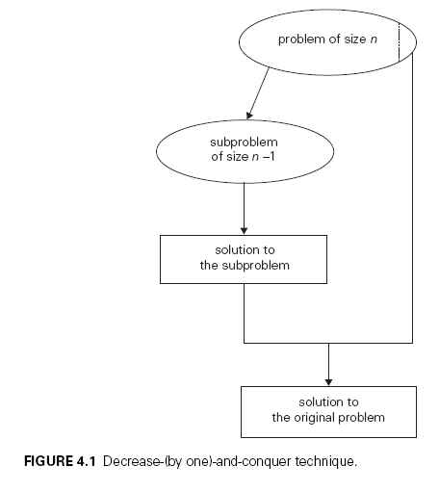

Slide 6
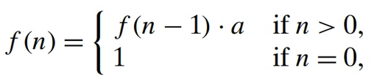
Example
The exponentiation problem of computing a^{n} where a ≠ 0 and n is a nonnegative integer : a^{n} = a^{n−1} × a
The function f (n) = a^{n} can be computed either “top down” by using its recursive definition or “bottom up” by multiplying 1 by a n times.
Still has a time efficiency class of Θ(n)

Slide 7
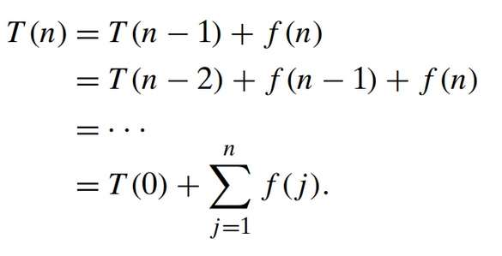
Recurrence
T(n)=T(n−1)+f(n)
Applying backward substitutions:

Slide 8
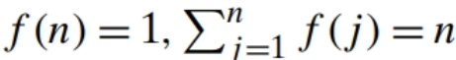
Examples

Slide 9
Decrease-by-a-Constant-Factor
Reducing a problem instance by the same constant factor on each iteration of the algorithm.
In most applications, this constant factor is equal to “2”.
See technique’s flow chart on next slide

Slide 11
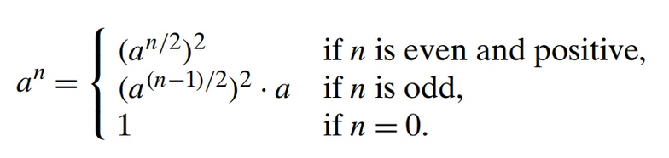
Example
The exponentiation problem of computing a^{n} where a ≠ 0 and n is a nonnegative integer : a^{n} = (a^{n/2})²
If n is odd, we have to compute a^{n−1} by using the rule for even-valued exponents and then multiply the result by a.
With a time efficiency class of Θ(log n)

Slide 12
Recurrence
T(n)=T(n/b)+f(n)
where b > 1 and function f (n) accounts for the time needed to reduce an instance to a smaller one and to extend the solution of the smaller instance to a solution of the larger instance.
valid only for n = b^{k}, k = 0, 1, . . ..
For values of n that are not powers of b, there is typically some round-off, usually involving the floor and/or ceiling functions.

Slide 13
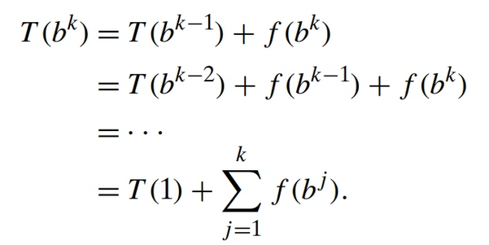
Recurrence
Applying backward substitution:

Slide 14
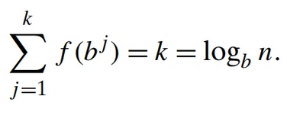
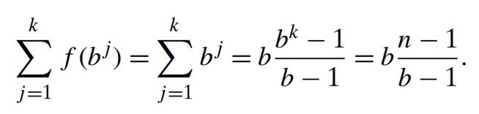
Examples
f (n) = 1 →
f (n) = n →

Slide 15
Variable-Size-Decrease
The size-reduction pattern varies from one iteration of an algorithm to another.
Example: Euclid’s algorithm for computing the greatest common divisor
gcd(m, n) = gcd(n, m mod n).
Though the value of the second argument is always smaller on the right-hand side than on the left-hand side, it decreases neither by a constant nor by a constant factor.

Slide 16
Insertion Sort
A decrease-by-one technique to sorting an array A[0..n − 1].

Slide 17
Example

Slide 18
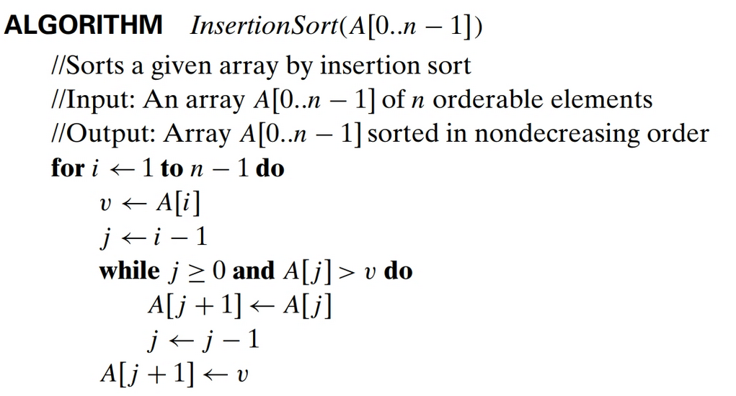
Algorithm

Slide 19
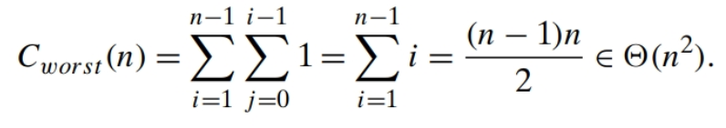
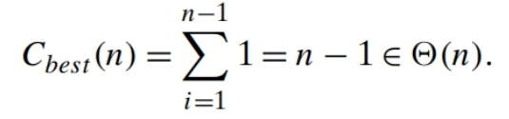
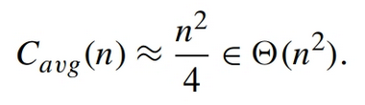
Time Efficiency

Slide 20
Digraph
Directed Graph (digraph): a graph with directions specified for all its edges
Differences between undirected and directed graphs in representing them:
(1) the adjacency matrix of a directed graph does not have to be symmetric;
(2) an edge in a directed graph has just one (not two) corresponding nodes in the digraph’s adjacency lists.

Slide 21
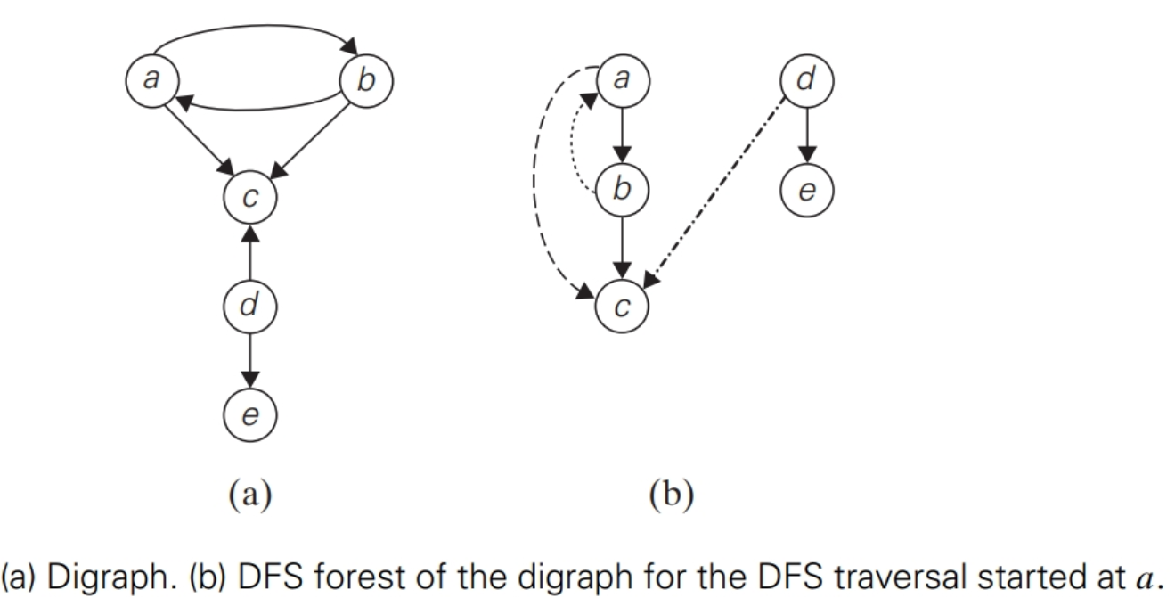
DFS Forest
Terminology:
Tree edge
Back edge
Forward edge
Cross edge
Directed cycle

Slide 22
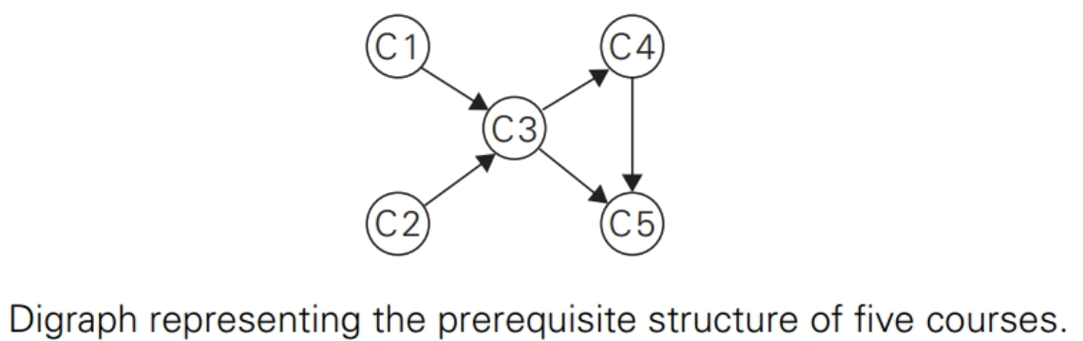
Topological Sorting
Listing vertices in such an order that for every edge in the graph, the vertex where the edge starts is listed before the vertex where the edge ends.
For topological sorting to be possible, a digraph in question must be a Directed Acyclic Graph (DAG):
If a DFS forest of a digraph has
no back edges, the digraph is a dag.
Example:

Slide 23
Topological Sorting Methods
Exhaustive Search: Perform a DFS traversal and note the order in which vertices become dead-ends (i.e., popped off the traversal stack). Reversing this order yields a solution to the topological sorting problem, provided, of course, no back edge has been encountered during the traversal.
Decrease-(by one)-and-conquer technique: Repeatedly, identify in a remaining digraph a source, which is a vertex with no incoming edges, and delete it along with all the edges outgoing from it. (A.K.A. Elimination Method)

Slide 24
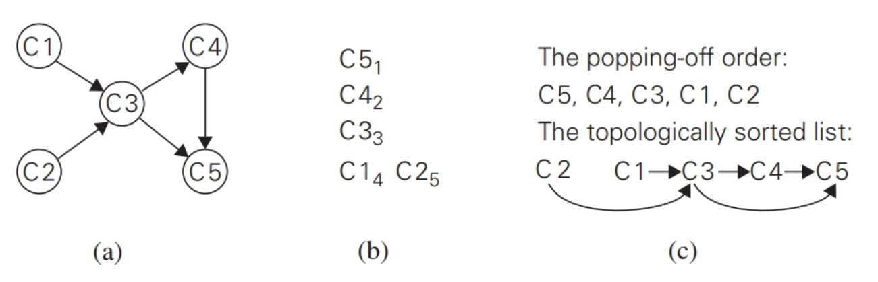
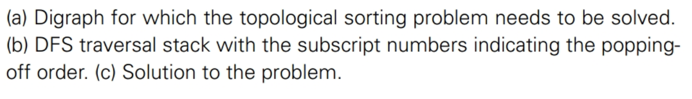
1. DFS Method Example:

Slide 25
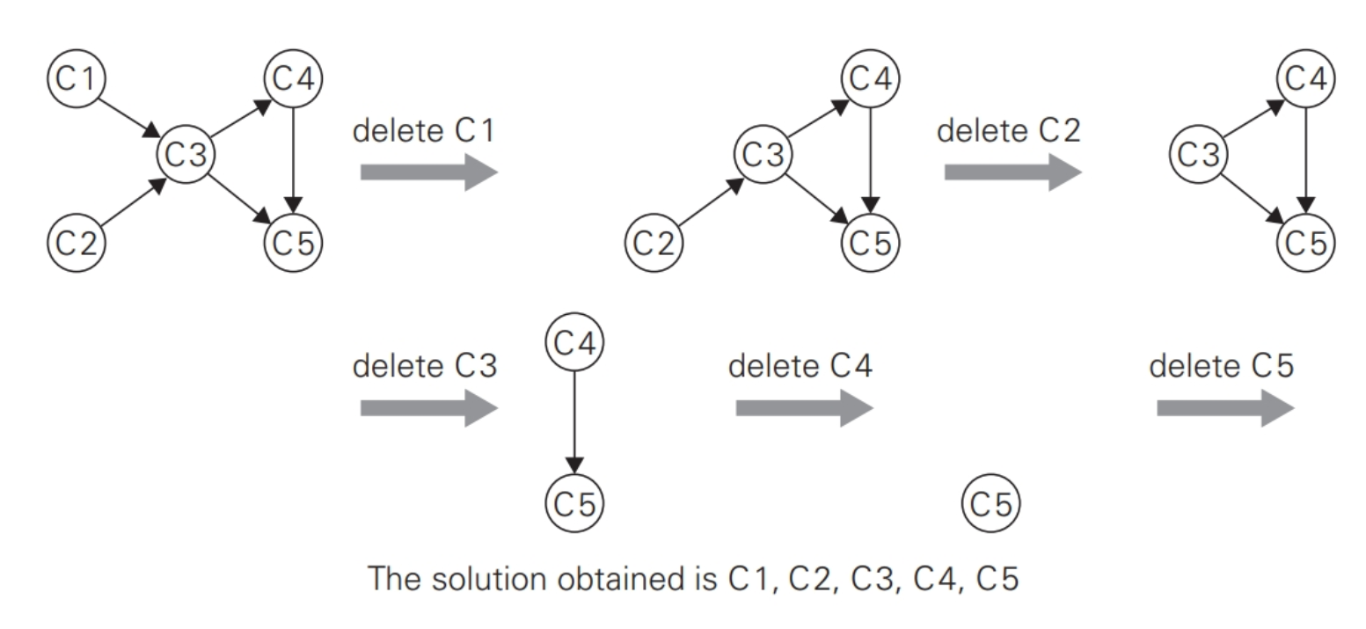
2. Elimination Method Example:

Slide 26
Usage
Imagine a large project—e.g., in construction, research, or software development—that involves a multitude of interrelated tasks with known prerequisites. The first thing to do in such a situation is to make sure that the set of given prerequisites is not contradictory. The convenient way of doing this is to solve the topological sorting problem for the project’s digraph. Only then can one start thinking about scheduling tasks to, say, minimize the total completion time of the project.

Slide 27
Applications of topological sorting in computer science
Instruction scheduling in program compilation,
Cell evaluation ordering in spread- sheet formulas, and
Resolving symbol dependencies in linkers.

Slide 28
Generating Combinatorial Objects
Generating Permutations
Minimal-Change (Decrease-By-One)
Johnson Trotter
Lexographic Permutation
Generating Subsets
Binary Reflected Gray Code

Slide 29
Algorithm
If n = 1 return 1; otherwise, generate recursively the list of all permutations of 12…n-1 and then insert n into each of those permutations by starting with inserting n into 12...n-1 by moving right to left and then switching direction for each new permutation.
Example:

Slide 30
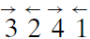
Definitions
Arrow-marked permutation:
Permutations where each number has an arrow above it
Example:
Mobile Element:
In an arrow-marked permutation, the element k is said to be mobile if its arrow points to a smaller number adjacent to it.
Example: In the arrow-marked permutation above 3 and 4 are mobile while 2 and 1 are not.

Slide 31
Algorithm

Slide 32
Example
See Board

Slide 33
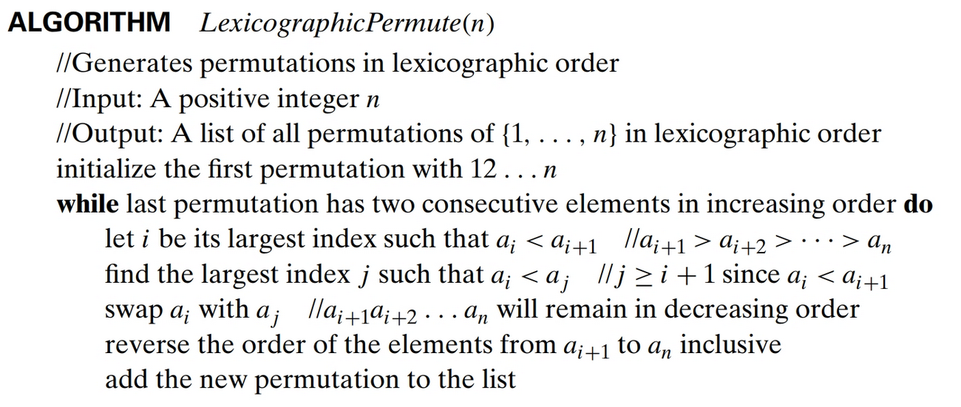
Algorithm

Slide 34
Example
See board

Slide 35
Generating Subsets
Power set: Set of all subsets of a set
Squashed order: Any subset involving a_{j} can be listed only after all the subsets involving a₁, . . . , a_{j−1}
Binary Reflected Gray Code: a cyclic minimal-change algorithm for generating bit strings so that every one of them differs from its immediate predecessor by only a single bit (by either an addition or a deletion, but not both, of a single element).

Slide 36
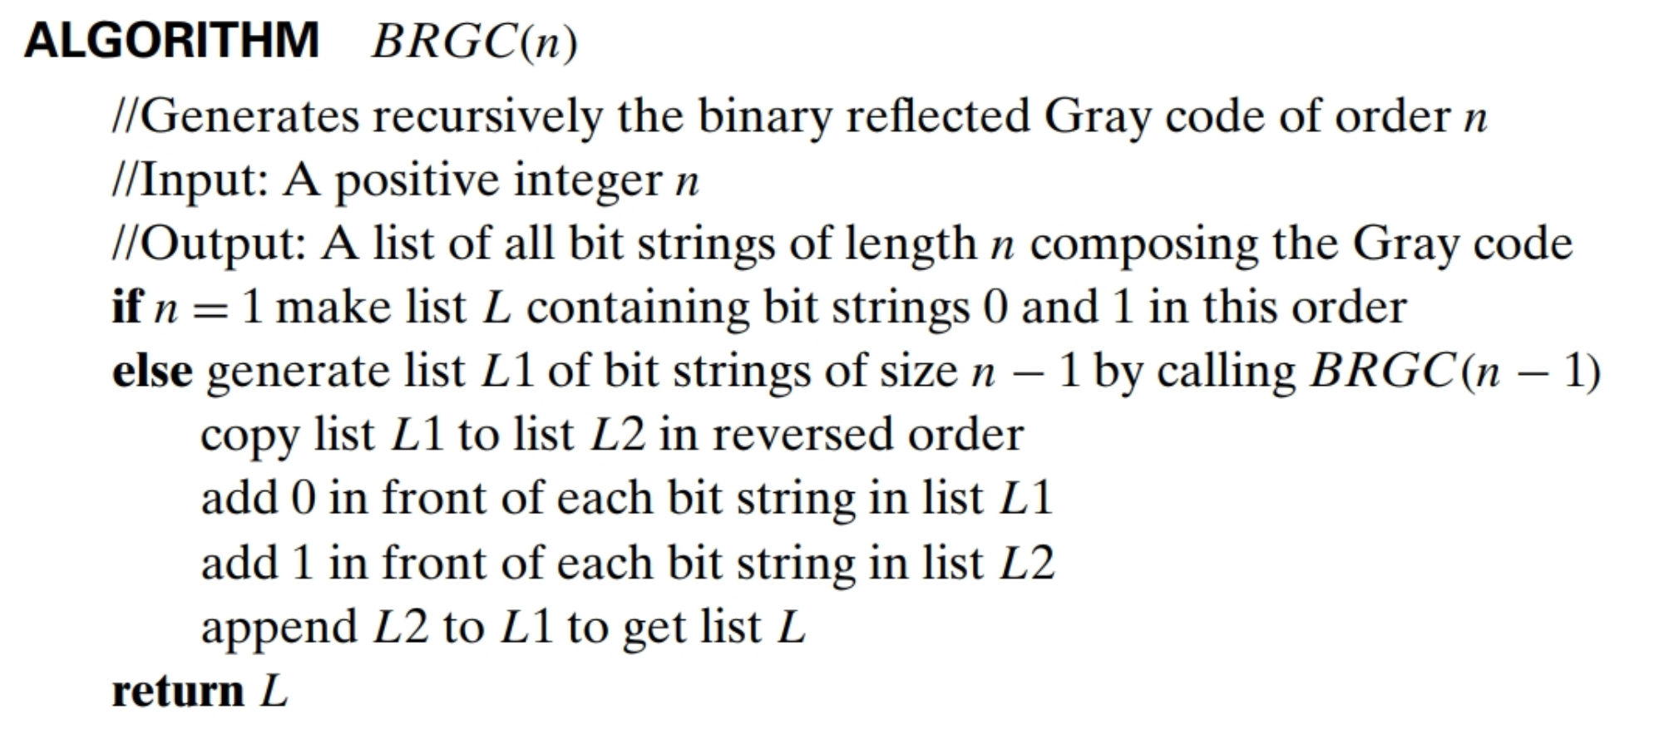
Algorithm

Slide 37
BRGC Example
For n = 3:
000 001 011 010 110 111 101 100.

Slide 38
BRGC Usage
Minimize the effect of errors in transmitting digital signals

Slide 39
Decrease by a Constant Factor
Binary Search
Fake-Coin Problem
Russian Peasant Multiplication
Josephus Problem

Slide 40
Binary Search
See slides 15 and 16 of textbook slides

Slide 41
Fake Coin Problem
Problem: design an efficient algorithm for detecting the fake coin.
Assumption: a fake coin is known to be lighter than a genuine one.
Algorithm:
Divide n coins into two piles of └n/2┘ coins each, leaving one extra coin aside if n is odd
put the two piles on the scale. If the piles weigh the same, the coin put aside must be fake;
otherwise, proceed in the same manner with the lighter pile, which must be the one with the fake coin.
Analysis: W(n) = W(└ n/2 ┘) + 1 for n > 1, W(1) = 0.
Solution: W(n) = └ log₂ n ┘

Slide 42
Russian Peasant Multiplication
Let n and m be positive integers whose product we want to compute:
if n is even, an instance of half the size has to deal with n/2:
n × m = n/2 × 2m.
if n is odd an instance of half the size has to deal with (n-1)/2 :
n × m =(n − 1)/2 × 2m + m

Slide 43
Russian Peasant Multiplication Example

Slide 44
Josephus Problem
Named after Flavius Josephus, a famous Jewish historian who participated in and chronicled the Jewish revolt of 66–70 c.e. against the Romans.
The Problem: Determine the survivor’s number of n people numbered 1 to n which stand in a circle where each dispatches (A.K.A. kills) the person next to them in order starting from 1 as a means of group suicide.

Slide 45
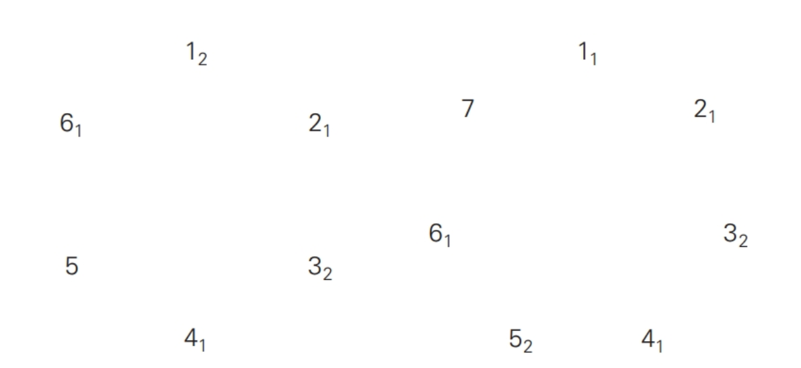
Josephus Problem Example
J(6) J(7)

Slide 46
Analysis
Even n: J(2k) = 2J(k) – 1
Odd n: J(2k + 1) = 2J(k) + 1
Shortcut:
J(n) can be obtained by a 1-bit cyclic shift of n itself:
Example: J(6) = J(110₂) = 101₂ = 5 and J(7) = J(111₂) = 111₂ = 7.

Slide 47
Variable-Size-Decrease Algorithms
Examples:
Selection Problems
Interpolation Search
Searching and Insertion in a Binary Search Tree
The Game of Nim

Slide 48
Selection Problem
The problem of finding the kth smallest element in a list of n numbers. This number is called the kth order statistic.
For k = 1 or k = n, we are looking for the smallest or largest element, respectively.
A more interesting case of this problem is for k =┌n/2┐, which asks to find an element that is not larger than one half of the list’s elements and not smaller than the other half. This middle value is called the median, and is one of the most important notions in mathematical statistics.

Slide 49
Partitioning
A rearrangement of a list’s elements around some value p so that the left part contains all the elements smaller than or equal to p, followed by the pivot p itself, followed by all the elements greater than or equal to p.

Slide 50
Two principal ways to partition an array
One-directional scan (Lomuto’s partitioning algorithm)
Two-directional scan (Hoare’s partitioning algorithm)

Slide 51
Lomuto Partitioning

Slide 52
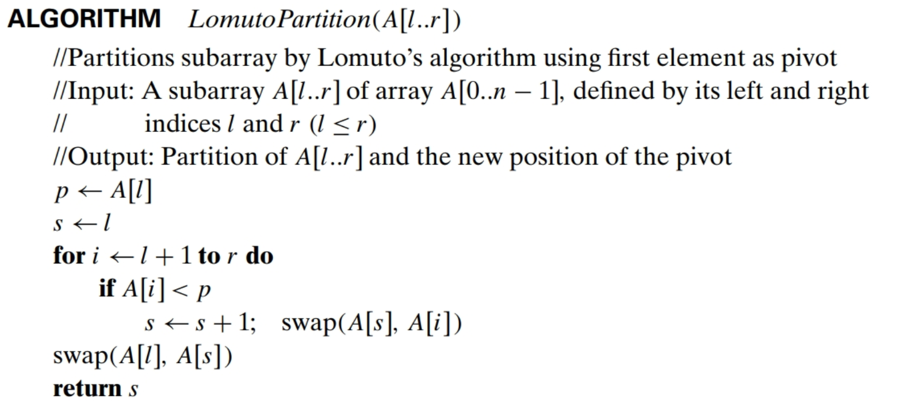
Lomuto Partitioning Algorithm

Slide 53
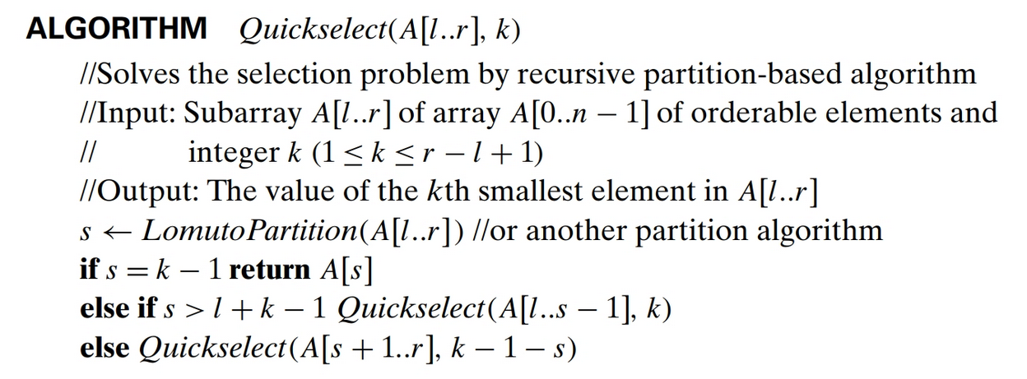
Quickselect

Slide 54
Quickselect Example
Find the median of 4, 1, 10, 9, 7, 12, 8, 2, 15
Translation to a selection proble:
n = 9
k = ⎡9/2⎤ = 5
So we need to find the 5th smallest number

Slide 55
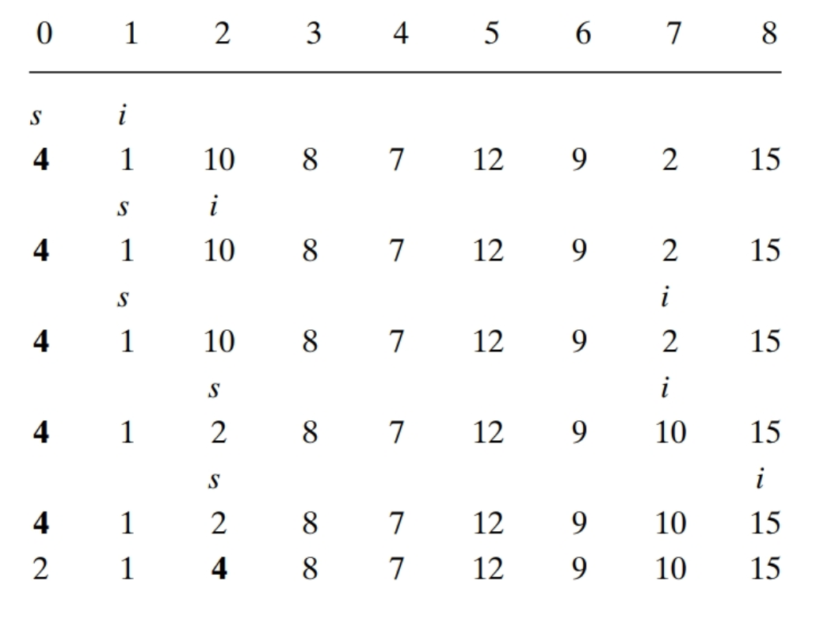
Quickselect Example Continued

Slide 56
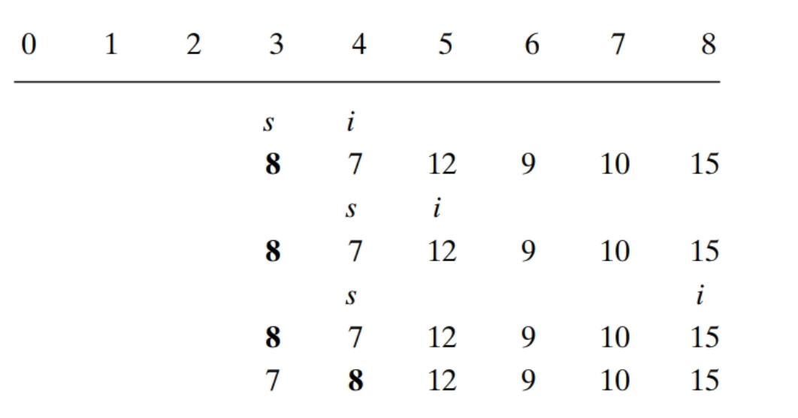
Quickselect Example Continued

Slide 57
Analysis
Cworst(n) = (n − 1) + (n − 2) + . . . + 1= (n − 1)n/2 ∈ Θ(n²)
a careful mathematical analysis has shown that the average-case efficiency is linear.
computer scientists have discovered a more sophisticated way of choosing a pivot in quickselect that guarantees linear time even in the worst case

